Slide 1




Programmable toy store in Toronto
IBM Data Science Capstone Project
By Jonathan Wang

Slide 2

Part 01
Introduction

Slide 3

A client who producing and selling programmable educational robot would like to set up a store in Toronto.
To choose the location, they want to find an area which meet following requirements:
Number of customers aged 3-22
The willingness of customers to buy the toy (with their income)
Safety
Less competition

Slide 4

Part 02
Background

Slide 5

Nowadays the training of children’s intelligence and logic becomes more and more important, but as a child, it is very hard to teach them to understand the difficult math and logic problems. How to make it easy for young boys and girls to become happy with logic training is a new problem of the era.
The programmable toys are designed for children and youth ages between 3 – 22 years old, it is absolutely a toy, and programmable/logic training robots as well which can make child ‘Learn from Try’.

Slide 6
Part 03
Data description

Slide 7

Neighborhood Profile of Toronto
Neighborhood Crime Rates
Neighborhood and Postal Code
Geography information
Foursquare API

Slide 8

Part 04
Methodology

Slide 9
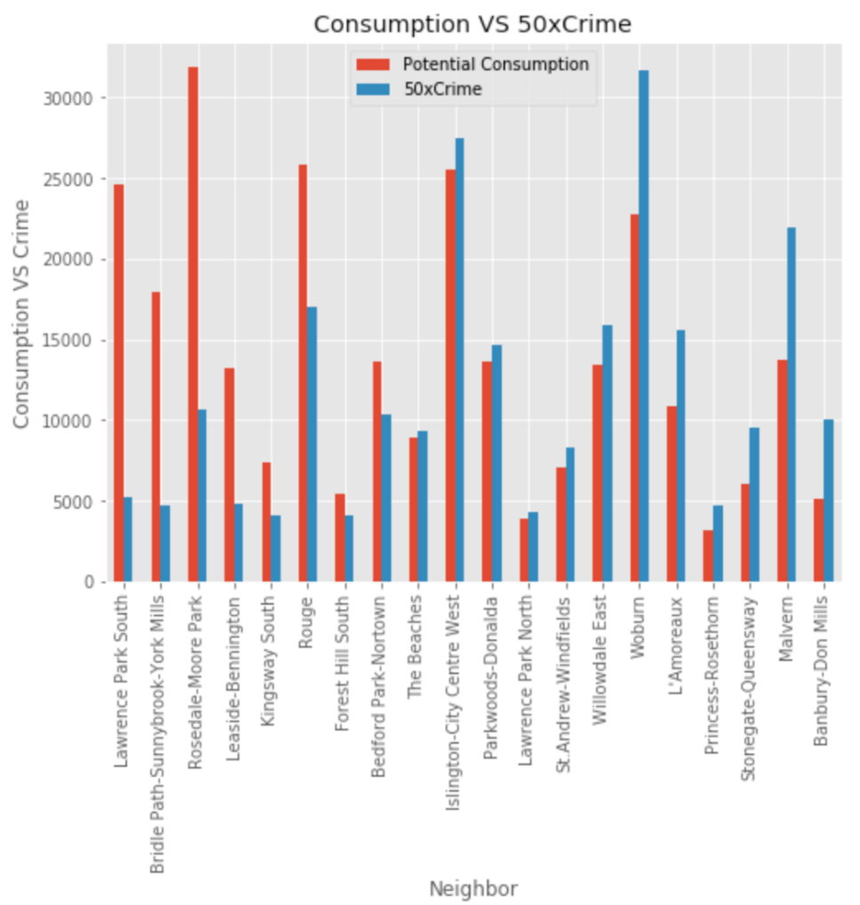
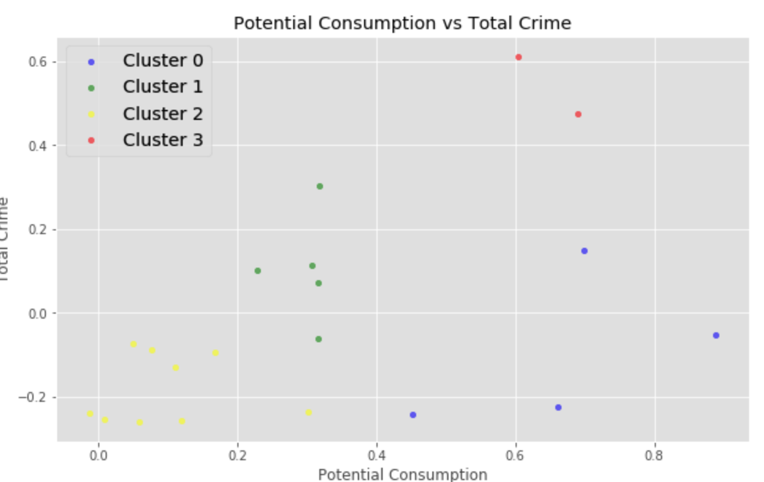
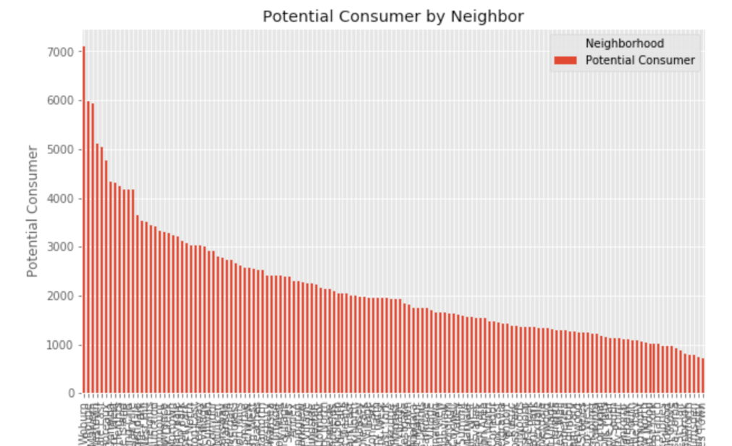
Dealing with Data
Generate Potential Consumer data
Consumption vs Crime
Mean normalization data
Perform K-Means Cluster Neighborhoods
Visualize Data

Slide 10
Part 05
Results

Slide 11
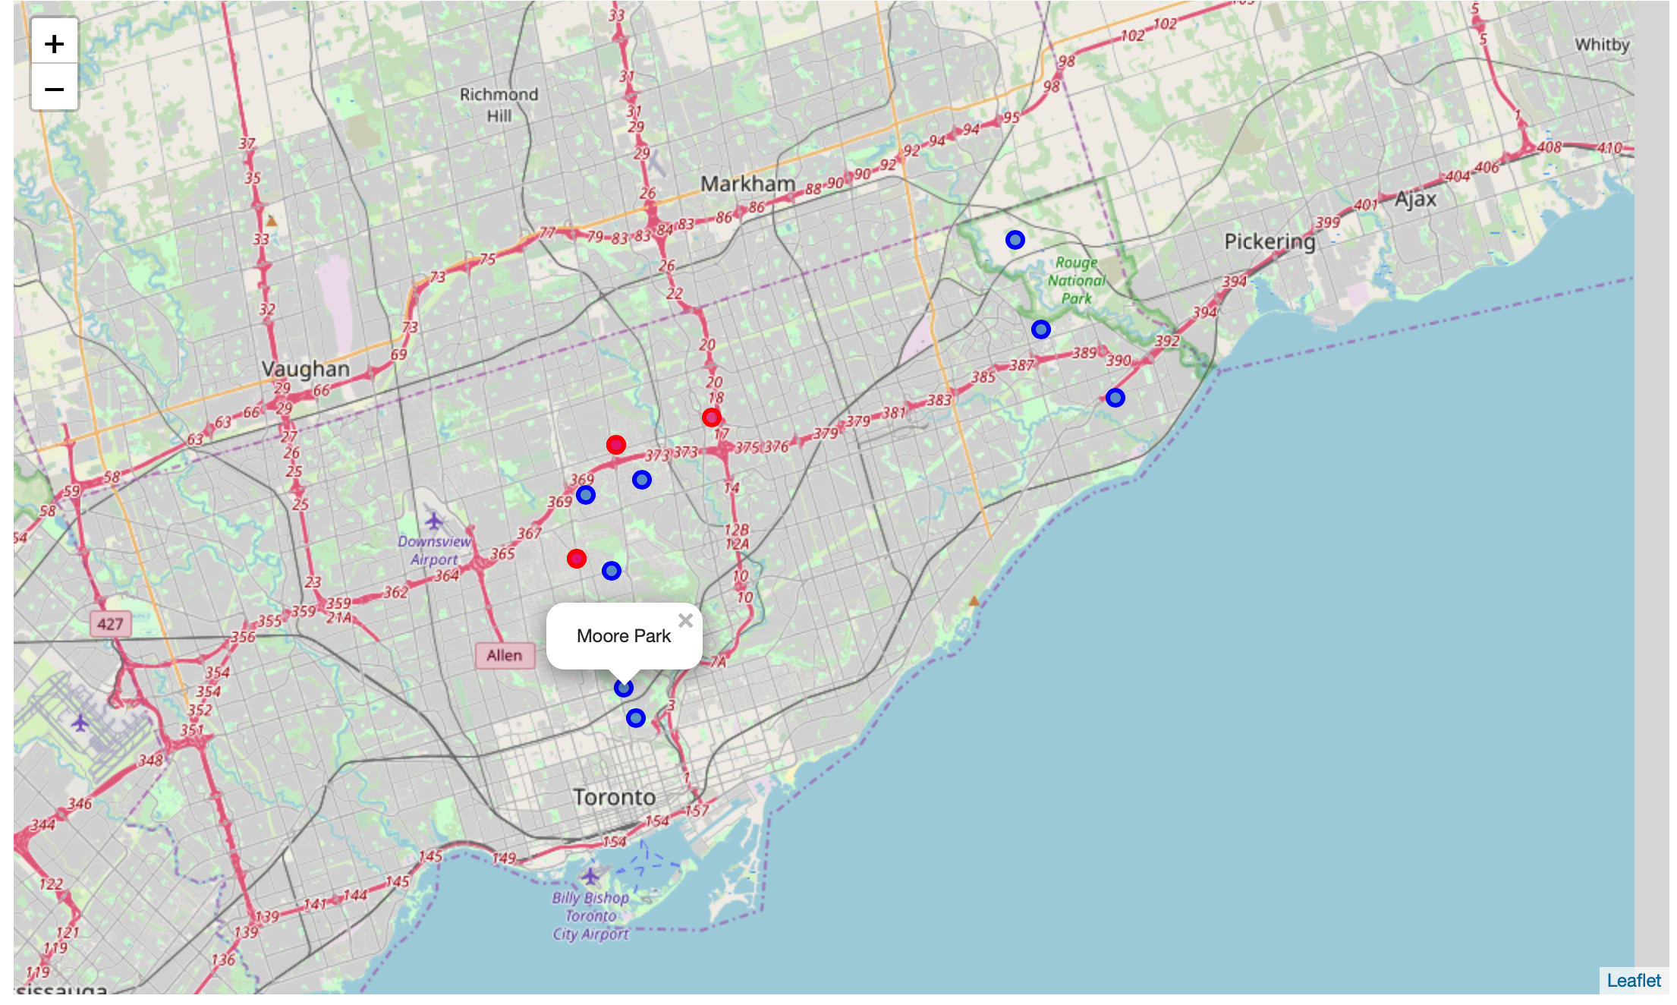
Low competition: Moore
Rosedale
Rouge
Willing to fight: Lawrence
York

Slide 12

Part 06
Discussion & Conclusion

Slide 13
If we can search more data on Foursquare, what will be the result?
What is the trend of children and youth in these neighborhoods? Saying if we dig deep into working age (25 – 35 years old maybe), those neighborhoods might have more babies in the recent future.
Although there could be more possible locations to set up the store, it’s still fine to pick up location in the neighborhoods above. Not only toy stores, but also all kinds of children related shops could be established there. People could obtain a lot of information through the map services. This project gives an example of process data and chose location in a large range of area.

Slide 14

Thanks
I would like to express my gratitude
to Coursera and IBM Data Science Course
for providing this course for me to learn the skills I need
March 2020

